Slide 1
Stored Procedure with Triggers
Lab # 11

Slide 2
Triggers :
A trigger is a special kind of a store procedure that executes in response to certain action on the table like insertion, deletion or updation of data. It is a database object which is bound to a table and is executed automatically.
Common Use :
Creating audit trails: This means writing out records that keep track of not just the most current data, but also the actual change history for each record. This may eventually become less popular with the change-data tracking that SQL Server 2008 added, but triggers are still a pretty popular choice

Slide 3
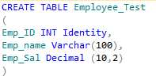
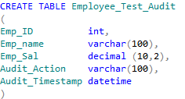

Triggers :
1 - Create a new table or use any other table from database
3- Create a table that will be used to track changes made in Employee_Test
2- As we have created a new table so lets insert some records in it

Slide 4
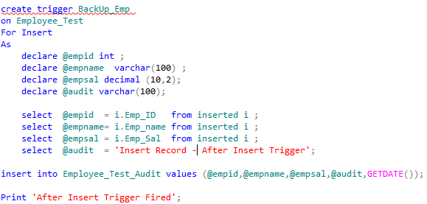
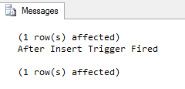
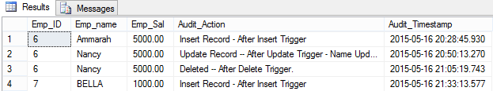
Trigger – After Insertion
select * from Employee_Test_Audit

Slide 5
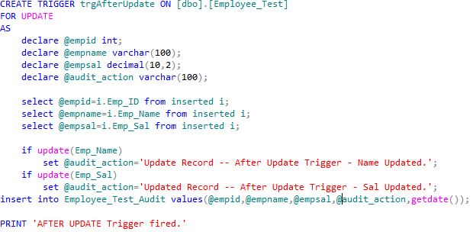
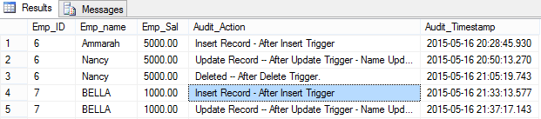
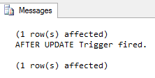
Trigger – After Updation

Slide 6
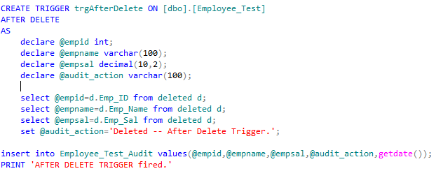
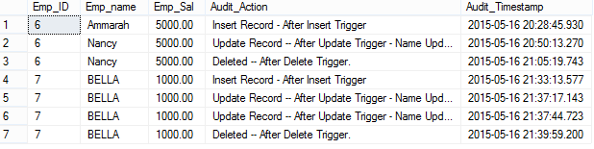
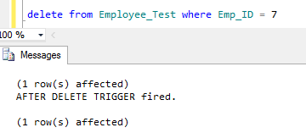
Trigger – After Deletion

Slide 7
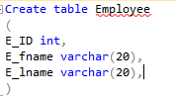
Example
Step 1 :
Create an Example Database Employee details
Step 2 :
Create table Employee with following fields:

Slide 8

Example
Step 3 :
Create table Employee_Log with following fields:

Slide 9
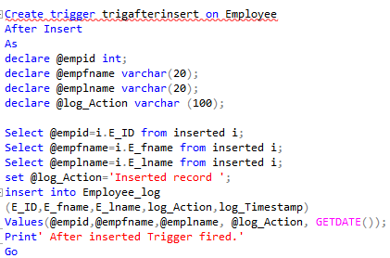
Example
Step 4 :
Create Trigger After insertion:

Slide 10
Example
Step 5 :
Insert Some Records in the Table Employee
Step 6 :
Write Select statement for Retrieving records from Table Employee_Log

Slide 11
Task - 1
Create
After Insert
After Update
After Delete
Triggers on Shippers Table in Northwind Database. Record query and their respective results in output.

Slide 12
References :
BOOK : Microsoft® SQL Server ® 2012 Programming by Paul Atkinson & Robert Vieira
http://www.codeproject.com/Articles/25600/Triggers-SQL-Server

